Slide 1
Stats 2 Project 1

Slide 2
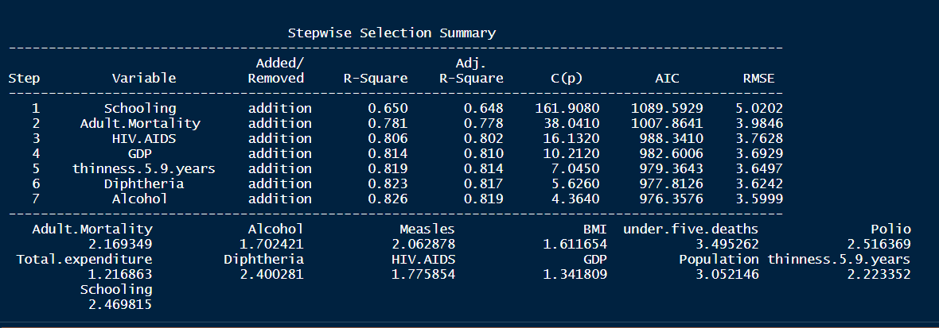
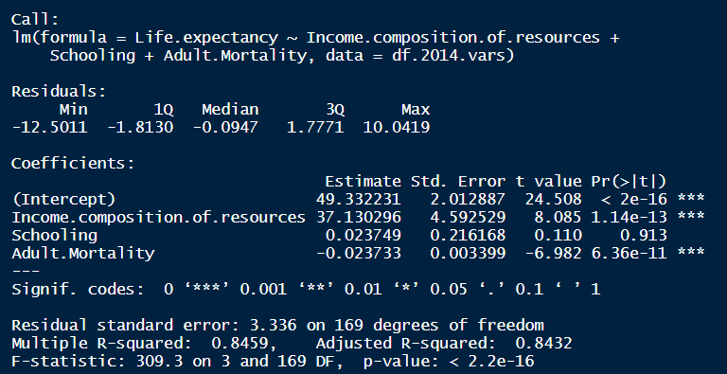
Adam’s Stepwise vs Anish’s Forward/Backward
How do we compare the two by AIC/BIC? Could we just call the Model using the variables and then print like Adam did above?

Slide 3
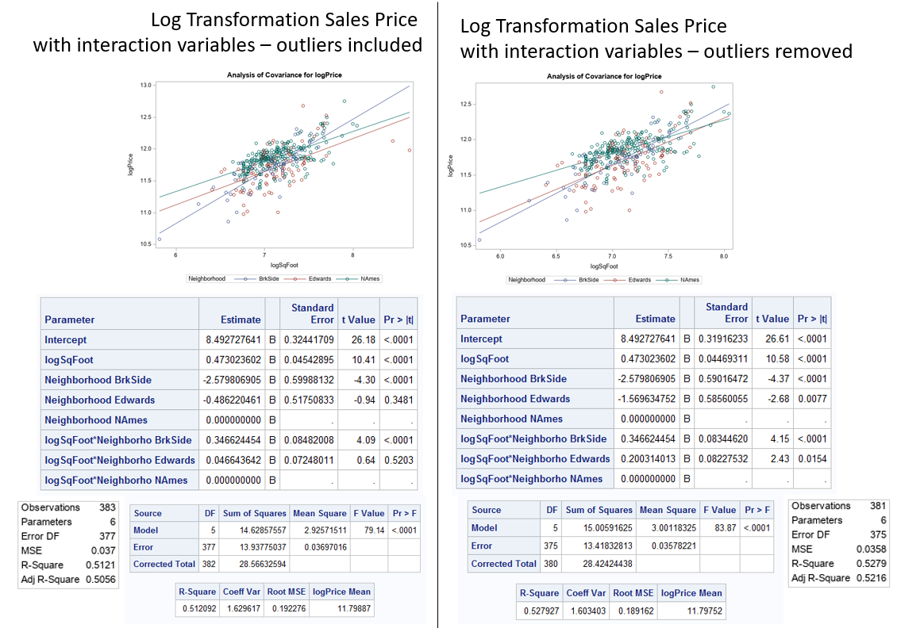
Example of Visualization of Outlier Included/Excluded
I just created these in a blank ppt presentation and then did a snippet to make for a clean JPG in word

